Slide 1
Distributed Mutual Exclusion:-Module-2

Slide 2
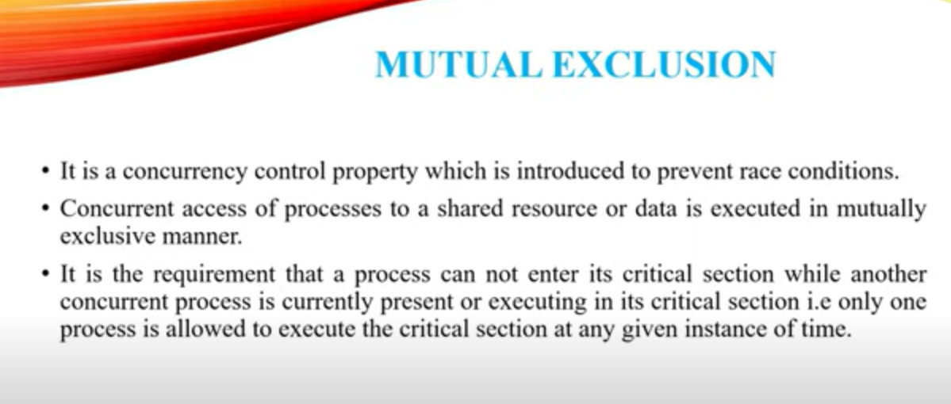

Slide 3
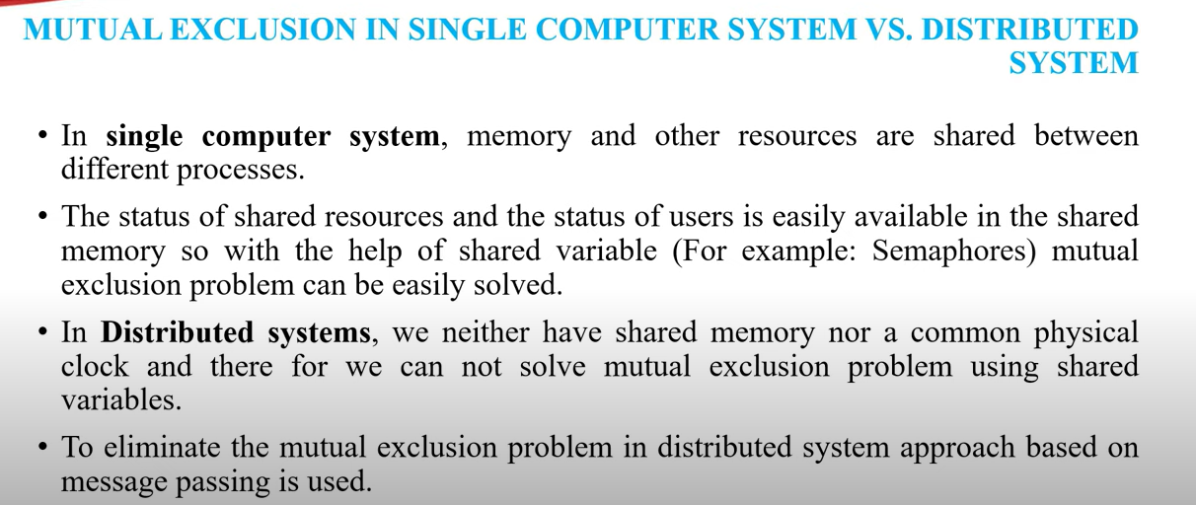

Slide 4
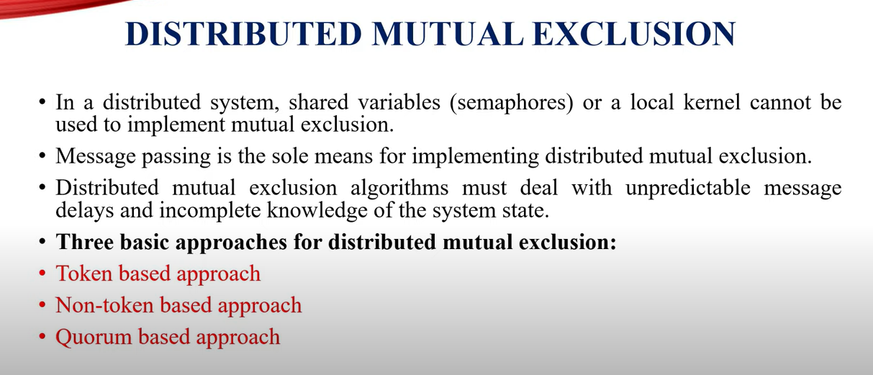

Slide 5
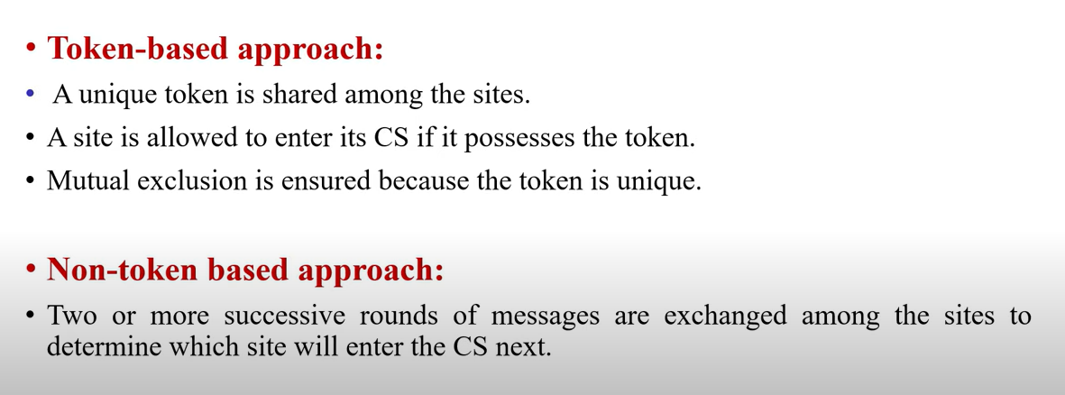

Slide 6
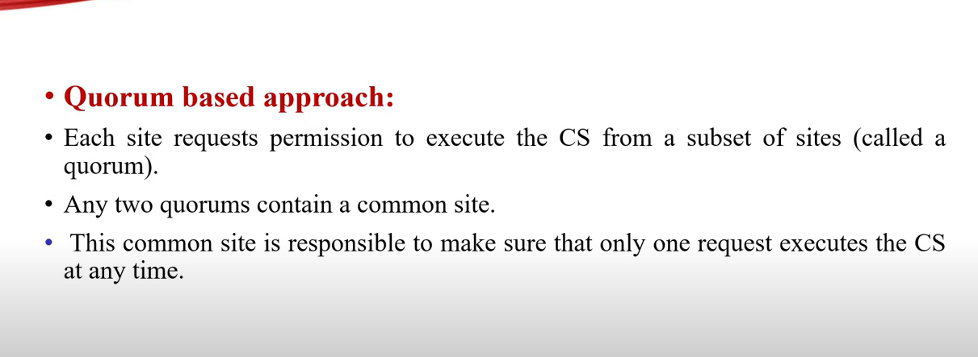

Slide 7
Requirements of MUTUAL EXCLUSION Algorithms
The primary objective of Mutual Exclusion algorithm is to guarantee that only one request access the Critical Section at a time.
In addition following characteristics are also considered important:
Freedom from dead locks: Two or more sites/process should not endlessly wait for messages that will never arrive.
Freedom from starvation: A site must not wait indefinitely to execute
the CS while other sites are repeatedly executing the CS.

Slide 8
Requirements of ME Algorithms
3. Fairness: Fairness property generally means that the CS execution requests are executed in order of their arrival in the system.
4. Fault Tolerance: In case of a failure, the algorithm can reorganize itself so that it continues to function without any disruptions

Slide 9
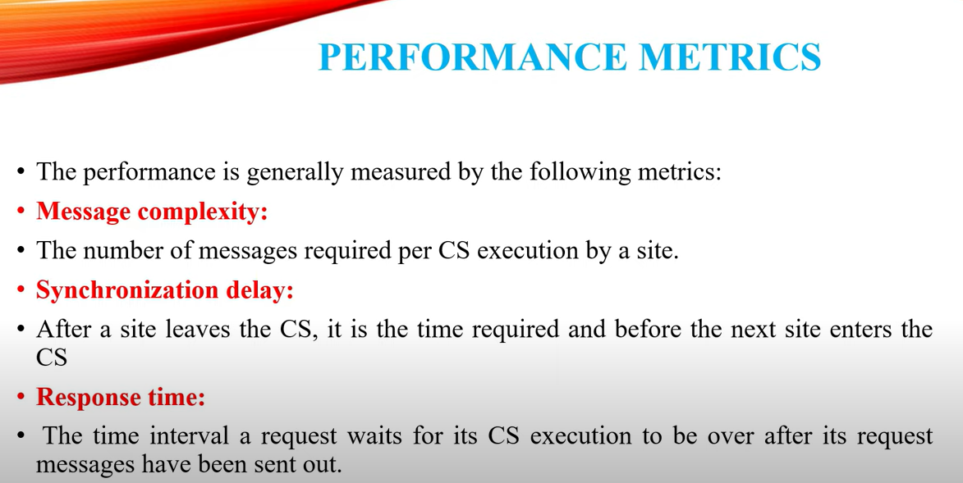

Slide 10
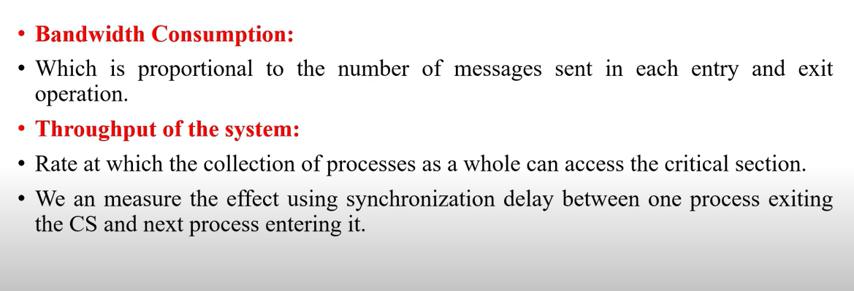
Performance Matrices

Slide 11
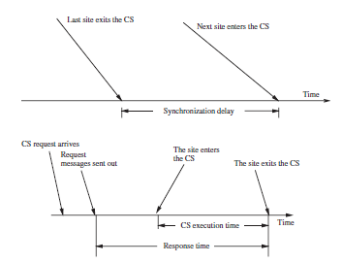
Performance Matrices
If SD is the synchronization delay and E is the average critical section execution time, then the throughput is given by the following equation:
System throughput = 1/(SD+E)

Slide 12
Low and high load performance
Performance of a mutual exclusion algorithm depends upon the load.
Performance of mutual exclusion algorithms are studied under two special loading conditions, “low load” and “high load.”
Under low load conditions, there is seldom more than one request for the critical section present in the system simultaneously.

Slide 13
Low and high load performance
Under heavy load conditions, there is always a pending request for critical section at a site.
A site is seldom in the idle state in heavy load conditions.
Performance metrics for Mutual Exclusion algorithms can be easily calculated with mathematical reasoning.

Slide 14
Best and worst case performance
In the best case, prevailing conditions are such that a performance metric attains the best possible value.
In most mutual exclusion algorithms the best value of the response time is a roundtrip message delay plus the CS execution time, 2T +E.
The best and worst cases coincide with low and high loads, respectively.

Slide 15
NON TOKEN BASED ALGORITHMS
In non token based algorithms a site communicate with a set of other sites to decide who should execute the CS next.
For a site Si Request set Ri contains ids of all those sites from which site Si must acquire permission before entering the CS
Non token based algorithms uses time-stamps to order requests for CS and to resolve conflicts between simultaneous requests for the CS
These algorithms maintain logical clocks and update them according to Lamport’s Scheme.
Each request for CS gets a timestamp and smaller time stamp requests gets priority over larger time stamp requests

Slide 16
Lamport’s Distributed Mutual Exclusion Algorithm
Lamport’s Distributed Mutual Exclusion Algorithm is a permission based algorithm proposed by Lamport as an illustration of his synchronization scheme for distributed systems.
permission based timestamp is used to order critical section requests and to resolve any conflict between requests.
In Lamport’s Algorithm critical section requests are executed in the increasing order of timestamps i.e a request with smaller timestamp will be given permission to execute critical section first than a request with larger timestamp.

Slide 17
Lamport’s Algorithm
In this algorithm
Three type of messages ( REQUEST, REPLY and RELEASE) are used and communication channels are assumed to follow FIFO order.
A site send a REQUEST message to all other site to get their permission to enter critical section.
A site send a REPLY message to requesting site to give its permission to enter the critical section.
A site send a RELEASE message to all other site upon exiting the critical section.
Every site S_{i}, keeps a queue to store critical section requests ordered by their timestamps.
request_queue_{i} denotes the queue of site S_{i}
A timestamp is given to each critical section request using Lamport’s logical clock.
Timestamp is used to determine priority of critical section requests. Smaller timestamp gets high priority over larger timestamp. The execution of critical section request is always in the order of their timestamp.

Slide 18
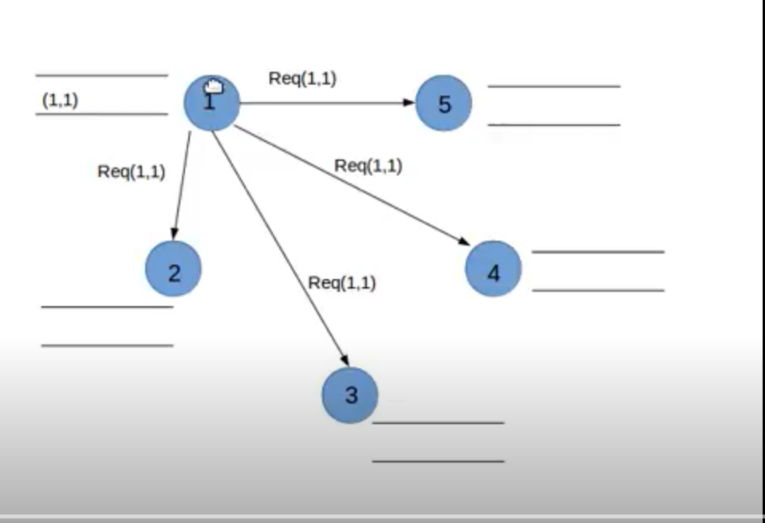
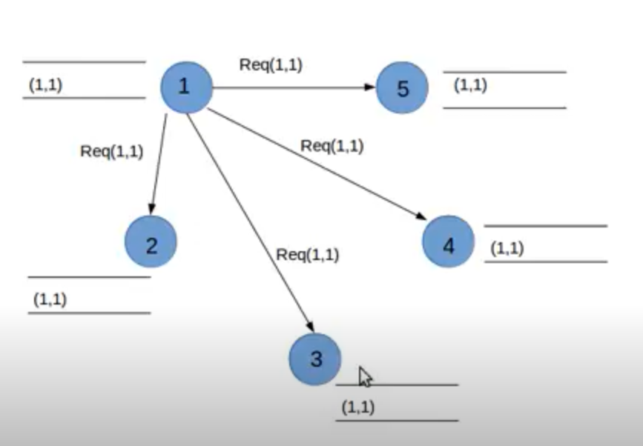
Example

Slide 19
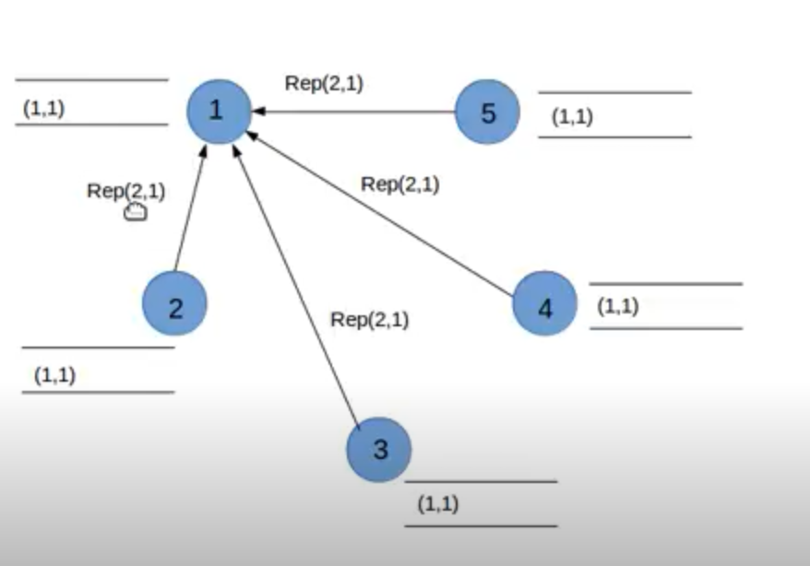
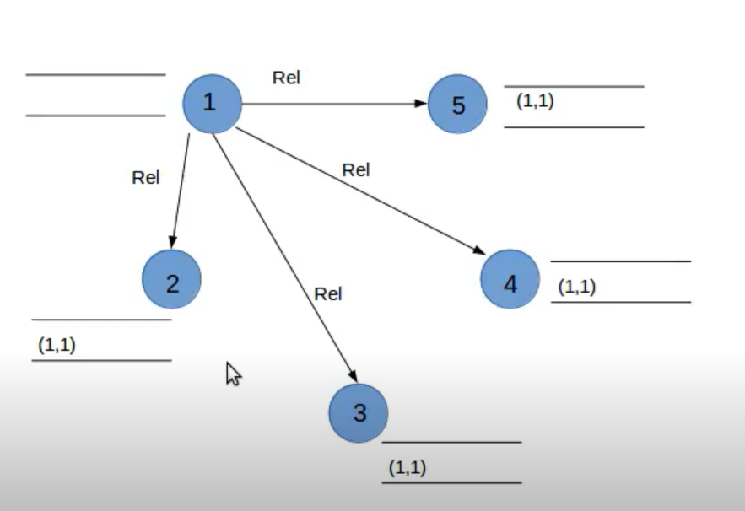
Example- continue

Slide 20
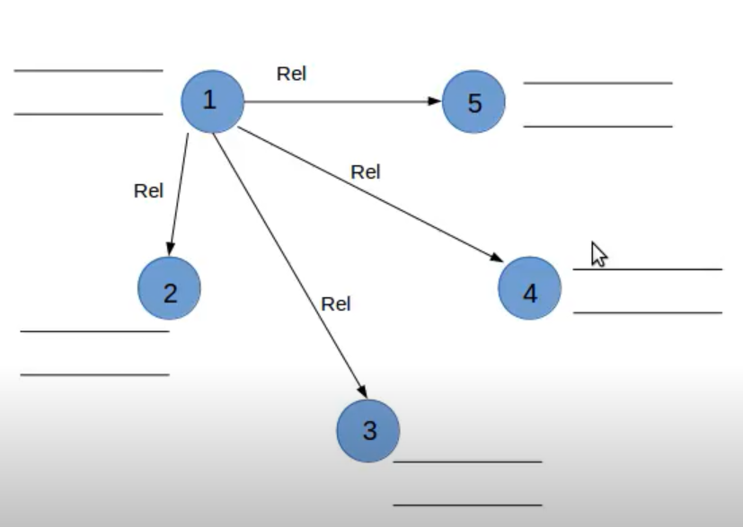

Slide 21
Algorithm
To enter Critical section
When a site S_{i} wants to enter the critical section, it sends a request message Request(ts_{i}, i) to all other sites and places the request on request_queue_{i}. Here, Ts_{i} denotes the timestamp of Site S_{i.}
When a site S_{j} receives the request message REQUEST(ts_{i}, i) from site S_{i}, it returns a timestamped REPLY message to site S_{i} and places the request of site S_{i} on request_queue_{j}
To execute the critical section
Site Si enters the CS when the following two conditions hold:
L1: Si has received a message with timestamp larger than (tsi, i) from all other sites.
L2: Si’s request is at the top of request_queuei

Slide 22
Algorithm
To release the critical section:
Site Si, upon exiting the CS, removes its request from the top of its request queue and broadcasts a timestamped RELEASE message to all other sites.
When a site Sj receives a RELEASE message from site Si, it removes Si’s request from its request queue.
When a site removes a request from its request queue, its own request may come at the top of the queue, enabling it to enter the CS.

Slide 23
Lamport’s algorithm: Performance
For each CS execution, Lamport’s algorithm requires N −1 REQUEST messages, N −1 REPLY messages, and N −1 RELEASE messages.
Ie, it requires 3(N-1) messages per CS invocation.
The Lamport’s Algorithm can be optimized by reducing the no:of message to lie between 3(N-1) and 2(N-1).
This can be achieved by supressing REPLY messages in certain situations

Slide 24
Ricart–Agrawala Algorithm in Mutual Exclusion in Distributed System
Ricart–Agrawala algorithm is an algorithm for mutual exclusion in a distributed system proposed by Glenn Ricart and Ashok Agrawala. This algorithm is an extension and optimization of Lamport’s Distributed Mutual Exclusion Algorithm. Like Lamport’s Algorithm, it also follows permission based approach to ensure mutual exclusion.
The Ricart–Agrawala algorithm assumes that the communication channels are FIFO.
The algorithm uses two types of messages:
REQUEST
REPLY.

Slide 25
Ricart–Agrawala Algorithm
A process sends a REQUEST message to all other processes to request their permission to enter the critical section.
A process sends a REPLY message to a process to give its permission to that process.
Lamport logical clocks to assign a timestamp to critical section requests.
Timestamps are used to decide the priority of requests in case of conflict. Smaller timestamp gets high priority over larger timestamp. The execution of critical section request is always in the order of their timestamp.
In this algorithm ,for every requesting site, the site with higher priority(smaller timestamp) will always defer the request of the lower priority site.
So the process with high priority gets to execute the CS

Slide 26
Ricart–Agrawala algorithm- Requesting critical section
When a site S_{i} wants to enter the critical section, it send a timestamped REQUEST message to all other sites.
When a site S_{j} receives a REQUEST message from site S_{i}, It sends a REPLY message to site S_{i} if and only if
Site S_{j} is neither requesting nor currently executing the critical section.
In case Site S_{j} is requesting, the timestamp of Site S_{i}‘s request is smaller than its own request.Otherwise the request is deferred by site S_{j}.

Slide 27
Ricart–Agrawala algorithm- Executing and Releasing critical section
Site S_{i} enters the critical section if it has received the REPLY message from all other sites.
Releasing the critical section.
When site Si exits the CS, it sends all the REPLY messages to all deferred requests.
The site with next highest priority request receives the last needed REPLY message and enters the CS

Slide 28
Ricart–Agrawala algorithm- Performance
For each CS execution, the Ricart–Agrawala algorithm requires N − 1 REQUEST messages and N − 1 REPLY messages.
Thus, it requires 2(N −1) messages per CS execution.

Slide 29
TOKEN-BASED algorithm
A unique token is shared among all sites
A site is allowed to enter its critical session if it possesses the token
Token based algorithms uses sequence numbers instead of time stamps
Every request for token contains a sequence number and sequence numbers of sites advance independently.
A site increments its sequence number counter every time it makes a request for token
Primary function of sequence number is to distinguish b/w old and current request for token

Slide 30
SUZUKI –KASami’s Broadcast algorithm
If a site attempting to enter a CS does not have the token, it broadcasts a REQUEST message for the token to all other sites.
A site that possesses the token sends it to the site that sends the REQUEST message.
If the site possessing the token is executing the CS, it sends the token only after it has exited the CS.
A site holding the token can repeatedly enter the critical session until it sends the token to some other site.

Slide 31
SUZUKI –KASami’s Broadcast algorithm
The main design issues in this algorithm are:
How to distinguishing an outdated REQUEST message from a current REQUEST message.
How to determine which site has an outstanding request for the CS

Slide 32
SUZUKI –KASami’s Broadcast algorithm
Outdated REQUEST messages are distinguished from current REQUEST messages in the following manner:
A REQUEST message of site Sj has the form REQUEST(j, n) where n (n = 1 2 ) is a sequence number that indicates that site Sj is requesting its nth CS execution.
A site Si keeps an array of integers RNi[1, … ,N] where RNi[j] denotes the largest sequence number received in a REQUEST message so far from site S.
When site Si receives a REQUEST(j, n) message, it sets RNi[j]= max(RNi[j], n).

Slide 33
SUZUKI –KASami’s Broadcast algorithm
When a site Si receives a REQUEST(j, n) message, the request is outdated if RNi[j]> n.
Sites with outstanding requests for the CS are determined in the following manner:
the token consists of a queue of requesting sites, Q, and an array of integers LN[1, … ,N], where LN[j] is the sequence number of the request which site Sj executed most recently.
After executing its CS, a site Si updates LN[i] : = RNi[i] to indicate that its request corresponding to sequence number RNi[i] has been executed.
Token array LN[1, … ,N] permits a site to determine if a site has an outstanding request for the CS.

Slide 34
SUZUKI –KASami’s Broadcast algorithm
In Site Si if RNi[j]=LN[j]+1, then site Sj is currently requesting a token.
After executing the CS, a site checks this condition for all the j’s to determine all the sites that are requesting the token and places their i.d.’s in queue Q if these i.d.’s are not already present in Q.
Finally the site sends the token to the site whose i.d. is at the head of Q.

Slide 35
Requesting the critical section:
If requesting site Si does not have the token, then it increments its sequence number, RNi[i], and sends a REQUEST(i, sn) message to all other sites. (“sn” is the updated value of RNi[i])
When a site Sj receives this message, it sets RNj[i] to max(RNj[i], sn). If Sj has the idle token, then it sends the token to Si if RNj[i]=LN[i]+1.

Slide 36
Executing and releasing the critical section:
Executing CS
Site Si executes the CS after it has received the token.
Releasing the CS
Having finished the execution of the CS, site Si takes the following actions:
It sets LN[i] element of the token array equal to RNi[i].
For every site Sj whose i.d. is not in the token queue, it appends its i.d. to the token queue if RNi[j] = LN[j]+1.
If the token queue is nonempty after the above update, Si deletes the top site i.d. from the token queue and sends the token to the site indicated

Slide 37
Potential Security Violations
Three categories of potential security violations are:
Unauthorized information release: This occurs when an unauthorized person is able to read and take advantage of the information stored in a computer system. This also includes the unauthorized use of a computer program.
Unauthorized information modification: This occurs when an unauthorized person is able to alter the information stored in a computer. Examples include changing student grades in a university database and changing account balances in a bank database.
Unauthorized denial of service: An unauthorized person should not succeed in preventing an authorized user from accessing the information stored in a computer.
External Vs. Internal Security
Computer system security can be divided into external security(physical) & internal security.

Slide 38
Design Principles for Secure Systems
Security Design Principles
Economy of Mechanism- A protection mechanism should be economical to develop and use
Complete Mediation- The design of a completely secure system requires that every request to access an object be checked for the authority to do so.
Open Design- The Open Design Design Principle is a concept that the security of a system and its algorithms should not be dependent on secrecy of its design or implementation.( A protection mechanism should work even if its underlying principles are known to an attacker.)
Separation of Privileges- A protection mechanism that requires two keys to unlock a lock( or gain access to a protected object) is more robust and flexible than one that allows only a single key to unlock a lock.
Least Privilege- A subject should be given the bare minimum access rights that are sufficient for it to complete its task.
Least Common Mechanism - The Least Common Mechanism design principle declares that mechanisms used to access resources should not be shared.
Acceptability- A protection mechanism must be simple to use. A complex and obscure protection mechanism will deter users from using it.
Fail-Safe Defaults- The Fail-Safe Defaults design principle pertains to allowing access to resources based on granted access over access exclusion. This principle is a methodology for allowing resources to be accessed only if explicit access is granted to a user. By default users do not have access to any resources until access has been granted. This approach prevents unauthorized users from gaining access to resource until access is given.

Slide 39
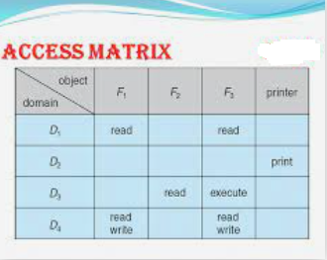
The Access Matrix Model
Access Matrix is a security model of protection state in computer system. It is represented as a matrix. Access matrix is used to define the rights of each process executing in the domain with respect to each object. The rows of matrix represent domains and columns represent objects.
Each cell of matrix represents set of access rights which are given to the processes of domain means each entry(i, j) defines the set of operations that a process executing in domain Di can invoke on object Oj.

Slide 40
Implementation of Access Matrix
Access matrix is likely to be very sparse and takes up a large chunk of memory. Therefore direct implementation of access matrix for access control is storage inefficient.
The inefficiency can be removed by decomposing the access matrix into rows or columns.Rows can be collapsed by deleting null values and so for the columns to increase efficiency. From these approaches of decomposition three implementation of access matrix can be formed which are widely used. They are as follows:
1. Capabilities
2. Access Control List
3. Lock and Key Method

Slide 41
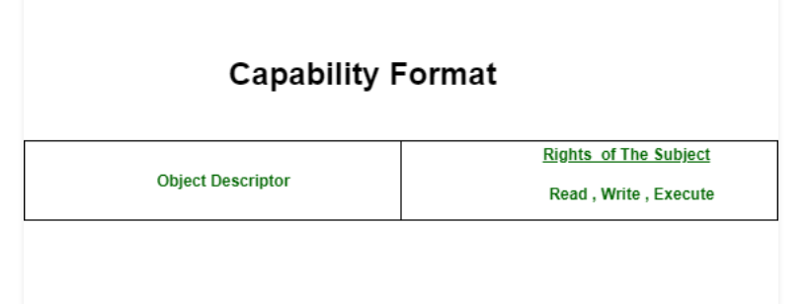
Capabilities:
Capabilities: This method refers to row wise decomposition of the access matrix. Each Subject is assigned with a list of tuples (o, M[s, o]) for all objects o that it is allowed to access. This tuples are called Capabilities. If a subject possess a capability (o, M[s, o]) then it is allowed to access object o in the manner which is described in M[s, o]. A subject is allowed to access any objects for which it holds the capabilities.Capabilities are not meant to be forged.Capabilities contain two fields:
1. Object Descriptor.
2. Access Rights.

Slide 42
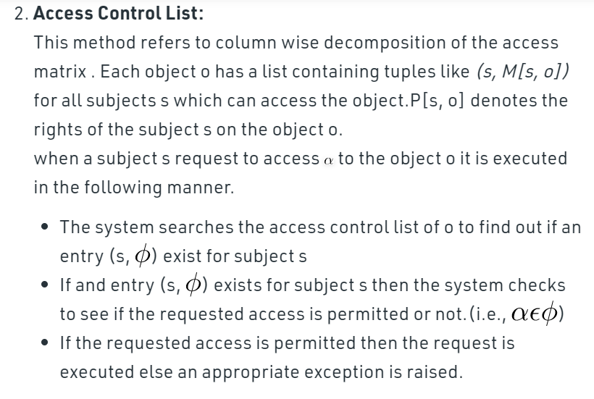
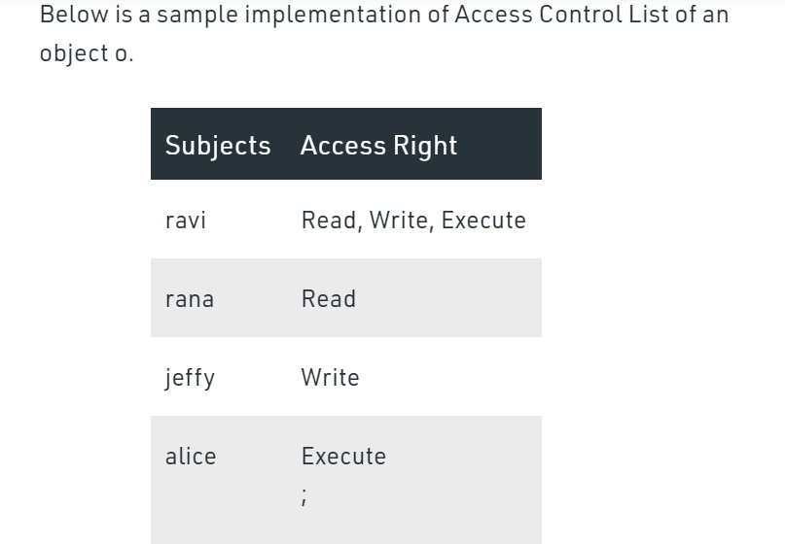
Access Control List:

Slide 43


